Slide 1
Virtual AI Health Assistant
Team Members
Manish Patel
SHIVAM MALLIK
AKASH PANDEY Project Guide : Mrs. Ruchika Chouhan
SHALLU JAIN

Slide 2
Introduction
With the help of Artificial intelligence we can create program or application which can have human intelligence and thinking and also better in some cases.
It is based on how any device observes its environment and takes actions based on the observed data to achieve the result successfully
A virtual assistant can conduct conversation with textual and auditory method. Example Google assistant, Alexa, IBM Watson, etc.
Similarly we can integrate these capabilities in the Health issues. To create an intelligent agent which can diagnose the symptoms of the patient.

Slide 3
Abstract
The purpose of this project is to provide health related information to the people through a virtual assistant which diagnoses the symptoms and provide a report of the problem.
This project is an attempt to provide medical and Health related help to the people through a device. It suggest medical help to the people on the base of the symptoms, age .
A Virtual Assistant can assist anyone and anytime.

Slide 4
Problem and Motivation
Health is an important factor to maintain now a days as there are so many diseases and viruses infecting mankind and causing a great damage to the mental health and also affecting the social life of the person.
A Health care Assistant is required to fulfil the need of the problem as everything is going digital so it will be help full to have a virtual health assistant which can consult you any time.

Slide 5
Innovation
AI chatbot through which people can easily chat and describe their problems.
Chatbot diagnoses the symptoms through AI and give solutions.
Symptoms Checker and Patients Triage.
Changing and enforcing health behaviors and monitor the patients Health and Workflow.
Connect the patients with appropriate medical service.
Increase Health care accessibility.

Slide 6
Continuation
Analyzes the Data in real time and look for possible diagnoses.
Assessment of likely conditions and suggestions of relevant symptoms.

Slide 7
Implementation and methodology
User validation and extraction of symptoms from the conversation with the user.
Accurate mapping of extracted symptoms to documented symptoms and their corresponding codes in the database.
Developing a personalized diagnosis and also referring the patient to an appropriate specialist if necessary.

Slide 8
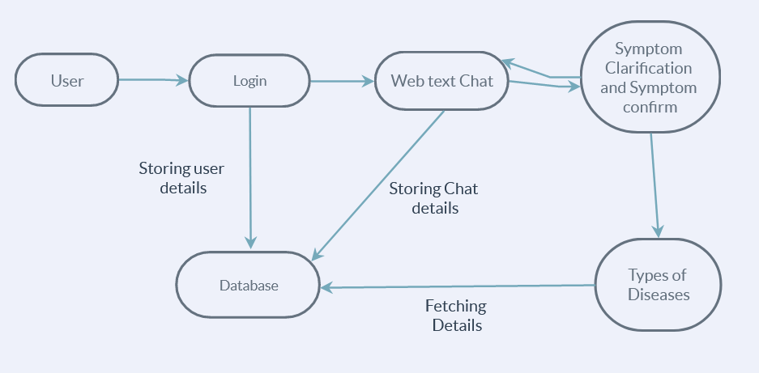
Functional Architecture

Slide 9
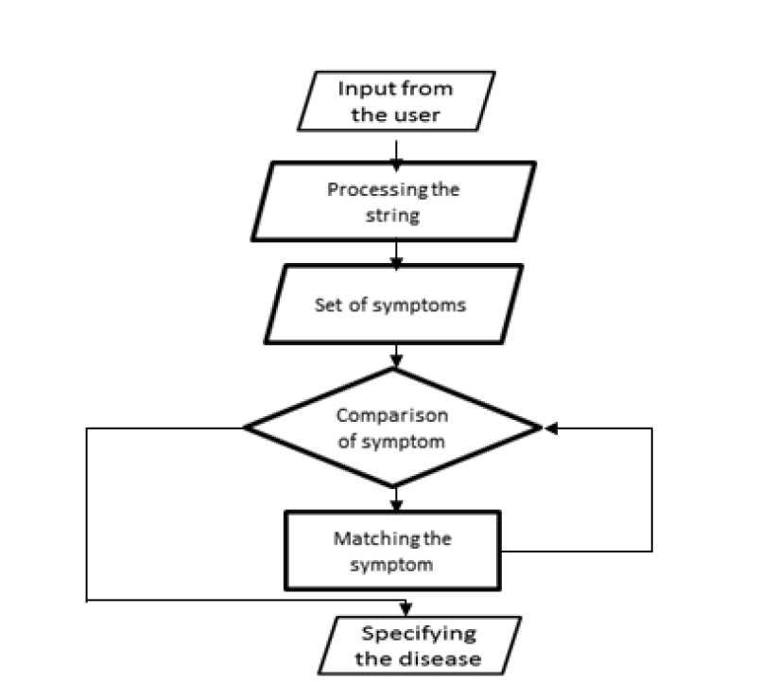
Specifying the disease

Slide 10
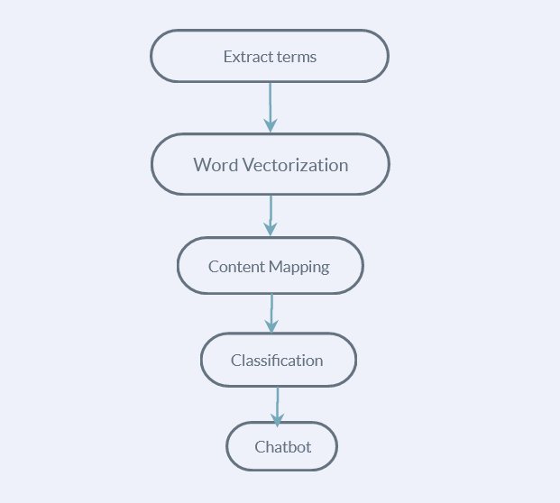
NLP Processing

Slide 11
Classification Algorithms
After the word vectorization in NLP through the Term Frequency.
Naive Bayes Classifier Algorithm is used to determine text classification that includes a high dimensional dataset.
It is helpful to generate a response of the input statement that meets the particular set of criteria.

Slide 12
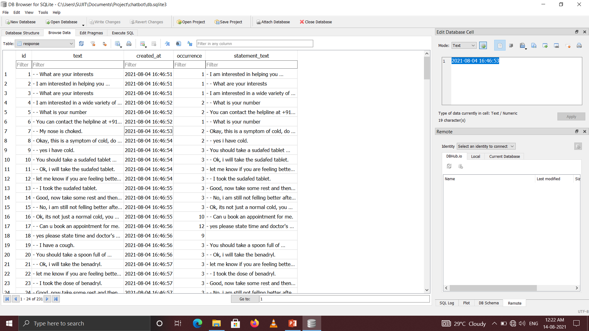
Screenshot

Slide 13
Future Scope
A virtual Health Assistant provides personalized diagnoses based on symptoms. In the future, the bot’s symptom recognition and diagnosis performance could be greatly improved by adding support for more medical features, such as location, duration, and intensity of symptoms, and more detailed symptom description.

Slide 14
Development Tools and Technology
HTML5, CSS
Javascript
Python
NLP
NODE JS
REACT JSEXPRESS JS
MONGO DB
Adobe
Visual Studio

Slide 15
Area
Self HealthCare Management
Web Application

Slide 16
Research paper summary
Sr no | Title | Publication | year | Algorithm | Advantages | Limitations
1 | Implementation of Chatbot System using AI and NLP. | IJIRCT | 2018 | AI & NLP | Get a more objectIve and occurate analysis. | training a model can take some time and its not 100% reliable.
2 | AI Based Medical Assistant Chatbot | HBRP | 2020 | NLP | Uses AIML method to interact and collect keywords info. | The model is created using unintelligent Chatbot, Its requires similar data set.
3 | Virtual Assistant and Patient Monitoring System by using AI & Data Science | IRJET | 2019 | ANN and NLP | It is more accurate than the traditional system. | Require high datasets to train the system.
4 | A Self-Diagnosis Medical Chatbot Using Artificial Intelligence | MAT | 2018 | NLP | Personalized diagnoses through AI algorithms. | Lack of more medical feature in personalized assistant.

Slide 17
Sr no. | Title | Publication | Year | Algorithm | Advantages | Limitations
5 | Virtual Nursing Assistant | GIS Science Journal | 2021 | NLP deep learning | Monitoring system for remote patients. | More process are required to implement the system time consuming
6 | Automated machine learning Review of the state-of-the-art and opportunities for healthcare | Elsevier | 2020 | AutoML | Automl optimizes the techniques of healthcare through different industries. | Difficult to deploy the Automl due to diverse datasets. Lack of transparency.
7 | AI Chatbot Design during an Epidemic like the Novel Coronavirus | MDPI | 2020 | AIML Pattern matching | Can be optimizes for new health problem through classification. | NLP has diagnostic issues in case of changing behavior.

Slide 18
Sr no. | Title | Publication | Year | Algorithm | Advantages | Limitations
8 | Chatbot for healthcare system using Artificial Intelligence | IJARIIT | 2019 | N-gram Term Frequency | Uses different techniques to minimize the errors. | Calculating the weight of TF is time consuming for bigger datasets.
9 | A Medical ChatBot | IJCTT | 2018 | NLP support vector algorithm | Better performance due to large datasets and has a voice output system. | The accuracy of the system is not similar through different algorithm.
10 | Conversational Artificial Intelligence Powered Chatbot for Delivering Tele-Health after COVID-19 | ICCES | 2020 | NLP | Addition of new Infections good for situation like lockdowns due to Google cloud platform. | GCP require to update the dataset which has to be done mainly.

Slide 19
Sr no. | Title | Publication | Year | Algorithm | Advantages | Limitations
11 | A Smart Chatbot Architecture based NLP and Machine Learning for health care Assistance | RG(Research Gate) | 2020 | NLP | AI can be used in healthcare as an assistant. | Grammar mistakes cannot be recognized.
12 | Use AI and ML to identify spreading infectious diseases | IJCRT | 2018 | AI and ML | AI and Modelling for better decision making. | Needs Human Surveillance. Although AI has come a long way in the medical world, human surveillance is still essential.
13 | Application of AI based Healthcare : Opportunities and Challenges | MDPI | 2021 | NLP | IMPROVE DETECTION AND TREATMENT | LIMIT OUR UNDERSTANDING OF FULL POTENTIAL OF FUTURE

Slide 20
Sr no. | Title | Publication | Year | Algorithm | Advantages | Limitations
14 | CHATBOT KIT: TOOL To Simulate Text based interaction between human and computer | IEEE | 2019 | NLP | Uses AIML method to interact and collect keywords info. | Lack of trust, security and privacy of data.
15 | An Overview of Machine Learning in Chatbots | IJME | 2020 | ANN and NLP | Better performance due to large datasets and has a voice output system. | NLP has diagnostic issues in case of changing behavior.
16 | Acceptability of artificial intelligence (AI)-led chatbot services in healthcare. | SAGE | 2019 | study about NLP | AI can be used in healthcare as an assistant. | Lack of trust,security and privacy of data.

Slide 21
Sr no. | Title | Publication | Year | Algorithm | Advantages | Limitations
17 | The Smart Health Care Prediction Using Chatbot. | IJRTE | 2020 | NLP | It can gather Customer Insights. | Chatbots can only handle basic Questions
18 | Contract Statements Knowledge Service for Chatbots. | IJMT | 2019 | AI | The user-friendly graphical user interface allows for rapid contract statement creation and updating with no technical skills required. | It require Constant Maintenance
19 | VIRTUAL HEALTHCARE ASSISTANT. | IJARIIE | 2017 | ML | Multiple Uses. | Chances of Customer Frustration.

Slide 22
Sr no. | Title | Publication | Year | Algorithm | Advantages | Limitations
20 | Artificial Intelligence Can Improve Patient Management at the Time of a Pandemic: The Role of Voice Technology. | JMIR | 2021 | AI | Improve patient management and organizational workflow. | May not cure all type of diseases.

Slide 23
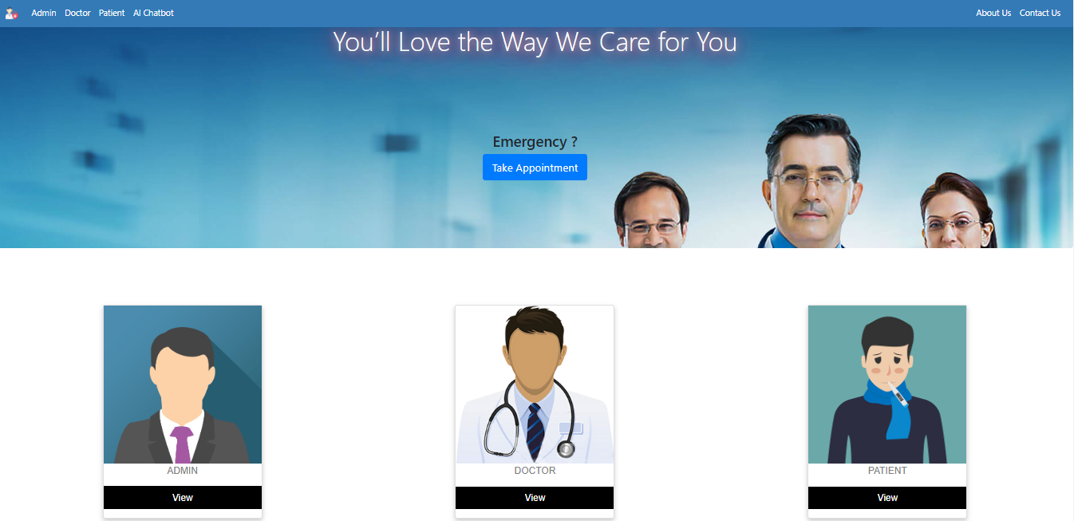
Implementation
Home Page

Slide 24
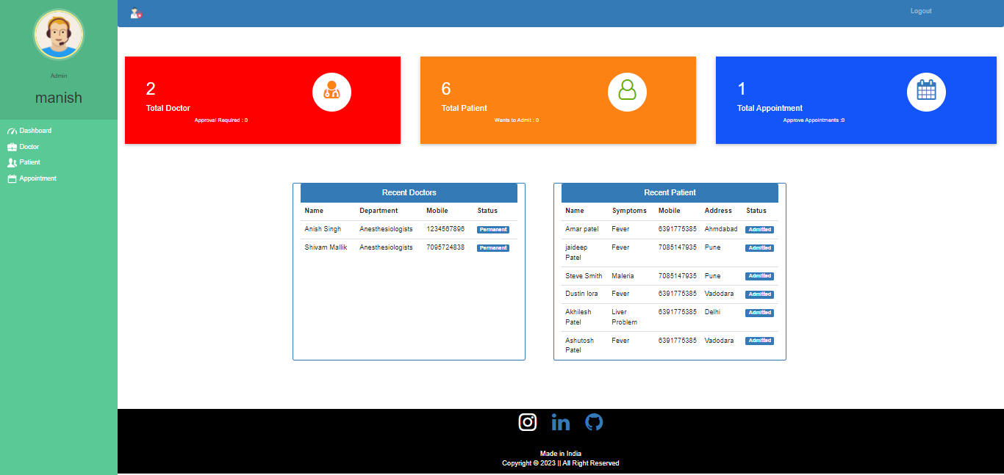
Admin Dashboard

Slide 25
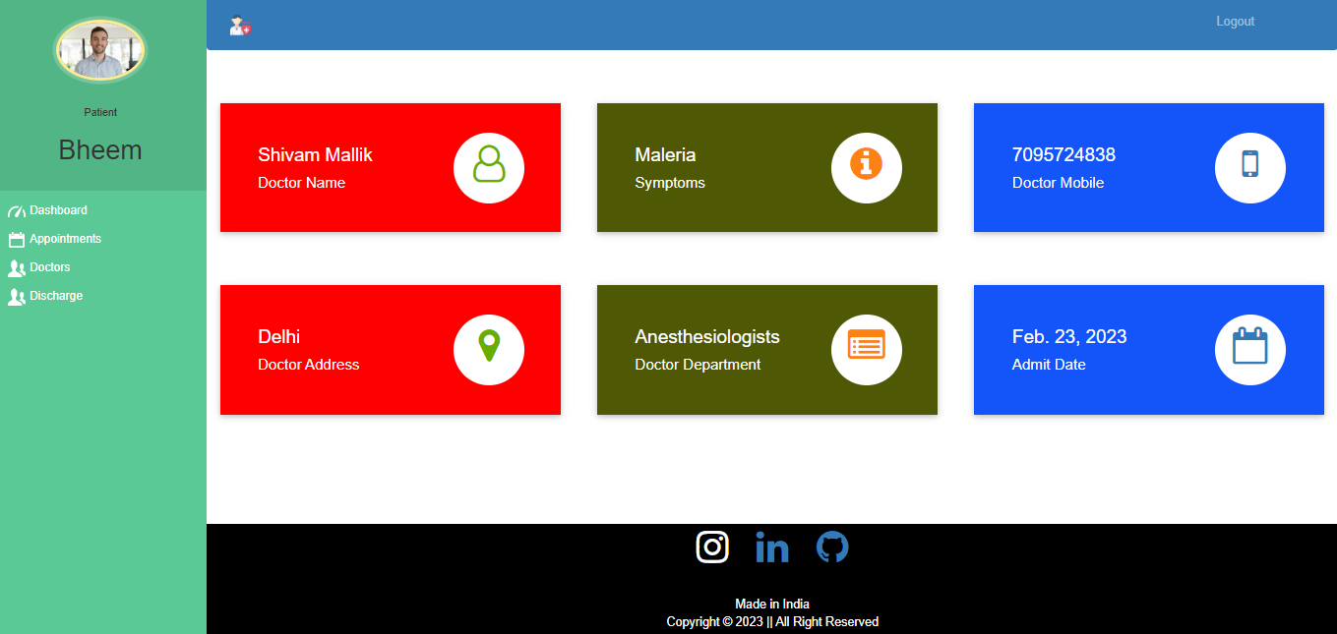
Patient Dashboard

Slide 26
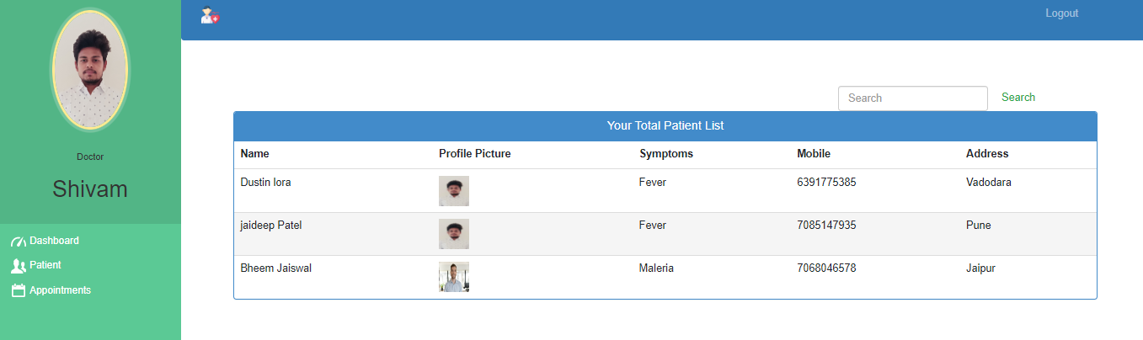
Doctor Dashboard

Slide 27
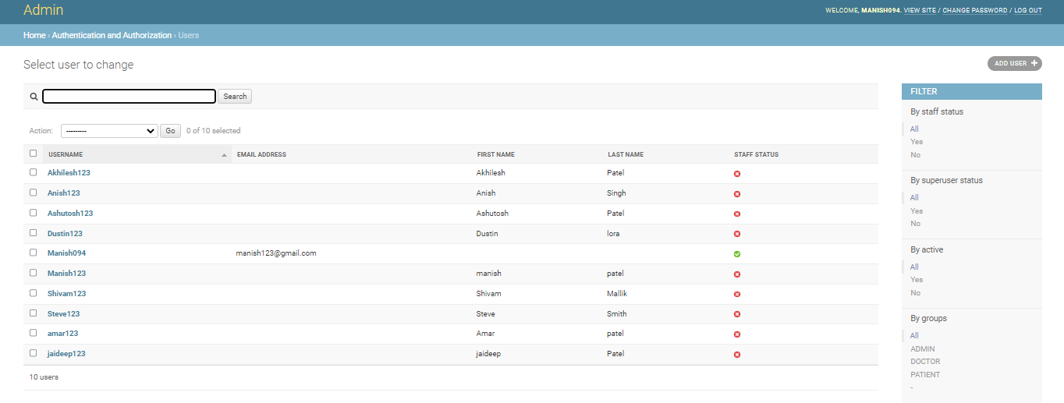
Database

Slide 28
Refernces
[1] Tom Nadarzynski1 , Oliver Miles2, Aimee Cowie3 and Damien Ridge1 “Acceptability of artificial intelligence (AI)-led chatbot services in healthcare: A mixed-methods study” SAGE 2019
[2] Chetan Bulla1, Chinmay Parushetti2*, Akshata Teli3, Samiksha Aski4, Sachin Koppad5 “AI Based Medical Assistant Chatbot” HBRP 2020
[3] Prof. Shital Patil1, Vrushali Patil2, Vidya Bagal3, Shubham Butala4 “Virtual Assistant and Patient Monitoring System by using AI & Data Science” IRJET 2019
[4] Divya S1, Indumathi V1, Ishwarya S1, Priyasankari M1, Kalpana Devi S2 “A Self-Diagnosis Medical Chatbot Using Artificial Intelligence” MAT 2018
[5] Praneet Kumar Ghosh TM1, Pragya Jain TM1, Shweta Wankhede TM1, Machani Preethi TM1, Dr. M K Jayanthi Kannan TM “ Virtual Nursing Assistant” GIS Science Journal 2021

Slide 29
[6] Jonathan Waringa,b,*, Charlotta Lindvallc,d, Renato Umetona,b,e “Automated machine learning: Review of the state-of-the-art and opportunities for healthcare” Elsevier 2020
[7] Gopi Battineni 1,* , Nalini Chintalapudi 1 and Francesco Amenta 1, “AI Chatbot Design during an Epidemic like the Novel Coronavirus” MDPI 2020
[8] Kavitha B. R, Dr. Chethana R. Murthy ”Chatbot for healthcare system using Artificial Intelligence” IJARIIT 2019
[9] Mrs. Rashmi Dharwadkar1, Dr.Mrs. Neeta A. Deshpande2 “A Medical ChatBot” IJCTT 2018
[10] Urmil Bharti, Deepali Bajaj, Hunar Batra, Shreya Lalit, Shweta Lalit, Aayushi Gangwani “Medbot: Conversational Artificial Intelligence Powered Chatbot for Delivering Tele-Health after COVID-19” ICCES 2020

Slide 30
Thank You !

